Slide 1
Group 15, the Nitrogen Group

Slide 2
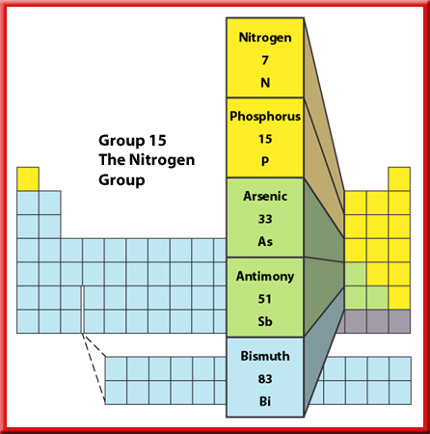
Representative Elements
Group 15—The Nitrogen Group
Nitrogen and phosphorus are required by living things and are used to manufacture various items.
These elements also are parts of the biological materials that store genetic information and energy in living organisms.

Slide 3
Representative Elements
Group 15—The Nitrogen Group
Although almost 80 percent of the air you breathe is nitrogen, you can’t get the nitrogen your body needs by breathing nitrogen gas.
Bacteria in the soil must first change nitrogen gas into substances that can be absorbed through the roots of plants.
Then, by eating some plants, nitrogen becomes available to your body.

Slide 4
Representative Elements
Group 15—The Nitrogen Group
Ammonia is a gas that contains nitrogen and hydrogen.
When ammonia is dissolved in water, it can be used as a cleaner and disinfectant.
Ammonia also can be converted into solid fertilizers.
It also is used to freeze-dry food and as a refrigerant.

Slide 5
Representative Elements
Group 15—The Nitrogen Group
The element phosphorus comes in two forms—white and red.
White phosphorus is so active it can’t be exposed to oxygen in the air or it will burst into flames.
The heads of matches contain the less active red phosphorus, which ignites from the heat produced by friction when the match is struck.

Slide 6
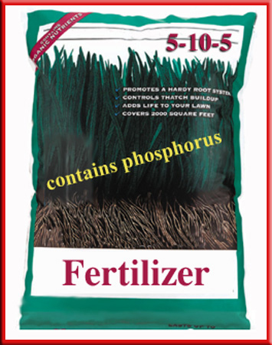
Representative Elements
Group 15—The Nitrogen Group
Phosphorous compounds are essential ingredients for healthy teeth and bones.
Plants also need phosphorus, so it is one of the nutrients in most fertilizers.

Slide 7
This powerpoint was kindly donated to www.worldofteaching.com
http://www.worldofteaching.com is home to over a thousand powerpoints submitted by teachers. This is a completely free site and requires no registration. Please visit and I hope it will help in your teaching.

